Slide 1


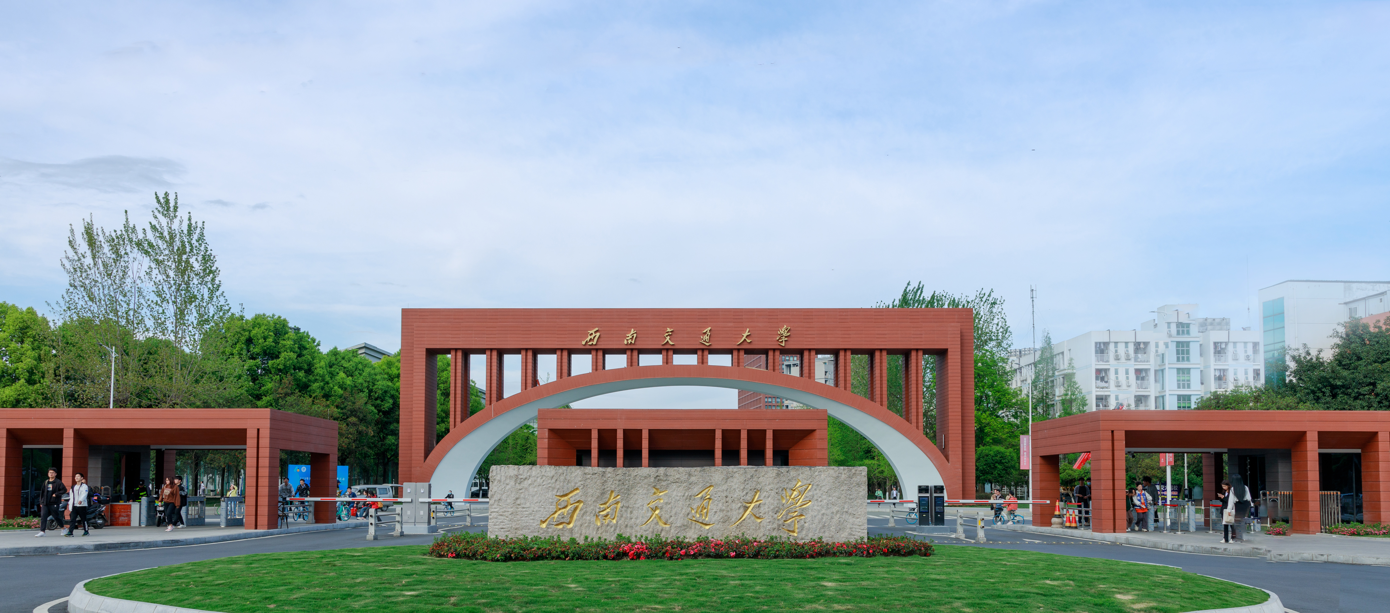


Chapter 10
Properties of Gases and Vapors
Lvcun Chen
School of Environmental Science and Engineering
chenlvcun@swjtu.edu.cn

Slide 2


10.1 Introduction 10.2 Vapor Pressure 10.3 Diffusivities 10.4 Gas-Liquid and Gas-Solid Equilibria 10.5 Chemical Reactions
CONTENTS

Slide 3
10.1 Introduction 10.2 Vapor Pressure 10.3 Diffusivities 10.4 Gas-Liquid and Gas-Solid Equilibria 10.5 Chemical Reactions
CONTENTS

Slide 4
10.1 Introduction
Why make a distinction between gases and vapors ?
One reason for making this distinction is that the behavior of gases can be accurately predicted using the ideal gas law, whereas concentrated vapors can show considerable deviation from ideal behavior. (which, is based on spherical, non-interacting, point-mass molecules)
However, the main reason for making a distinction between gases and vapors is because different control techniques can be applied to vapors than can be applied to gases.

Slide 5
10.1 Introduction
In air pollution work we often encounter the terms gas and vapor. People sometimes use the terms interchangeably.
Common properties of gases and vapors:
Both are composed of widely separated, freely moving molecules.
Both will expand to fill a larger, differently shaped container.
Both exert pressure in all directions.
In short, both are in the gaseous state of matter.

Slide 6
10.1 Introduction
The major difference lies in the internal energy (of the molecules).
A substance in the gaseous state is considered a true gas if it is far removed from the liquid state. Usually, this means that the temperature of the substance is above its critical point (the highest temperature at which it can be condensed).
A vapor is a substance in the gaseous state that is not far from being a liquid. The vapor can exist as dispersed molecules at a temperature not far above or even below its dew point (the temperature at which pure vapors at atmospheric pressure will condense). A vapor can usually be adsorbed onto surfaces or condensed into a liquid relatively easily.

Slide 7
10.1 Introduction
In air, we consider oxygen, nitrogen, argon, and carbon dioxide to be gases, whereas we refer to the water content as water vapor. The pollutants SO₂, NO, NO₂, and CO are considered gases,
whereas most volatile organic compounds (VOCs) are considered vapors (exceptions would be methane, ethane, ethylene, and other VOCs with low boiling points).

Slide 8
10.1 Introduction 10.2 Vapor Pressure 10.3 Diffusivities 10.4 Gas-Liquid and Gas-Solid Equilibria 10.5 Chemical Reactions
CONTENTS

Slide 9
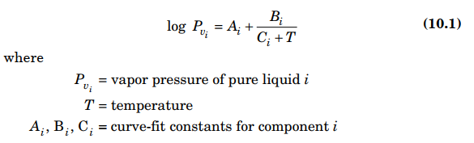
10.2 Vapor Pressure
Vapor pressure is defined as the pressure exerted by a pure component vapor in equilibrium with a flat surface of its pure component liquid at a certain temperature.
Vapor pressure increases rapidly with an increase in temperature. A common curve-fit equation for the vapor pressure/temperature relationship is the Antoine equation, which is

Slide 10
10.2 Vapor Pressure
Partial pressure can take on any value less than or equal to the vapor pressure, as long as no liquid is present.
If the system is not at equilibrium, there are no theoretical ties between vapor pressure and partial pressure.
When the system is at equilibrium with both vapor and liquid present, the vapor phase is said to be saturated, and the partial pressure is equal to the vapor pressure.

Slide 11
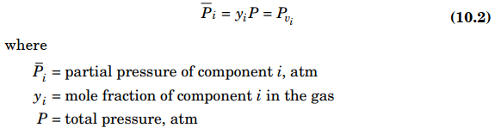
10.2 Vapor Pressure
When a pure liquid is placed in contact with air in a closed space, some of the liquid will volatilize (evaporate) until vapor–liquid equilibrium is established. At equilibrium, the partial pressure of the vapor (and thus the gas-phase composition) is dependent on the liquid’s vapor pressure; that is,

Slide 12
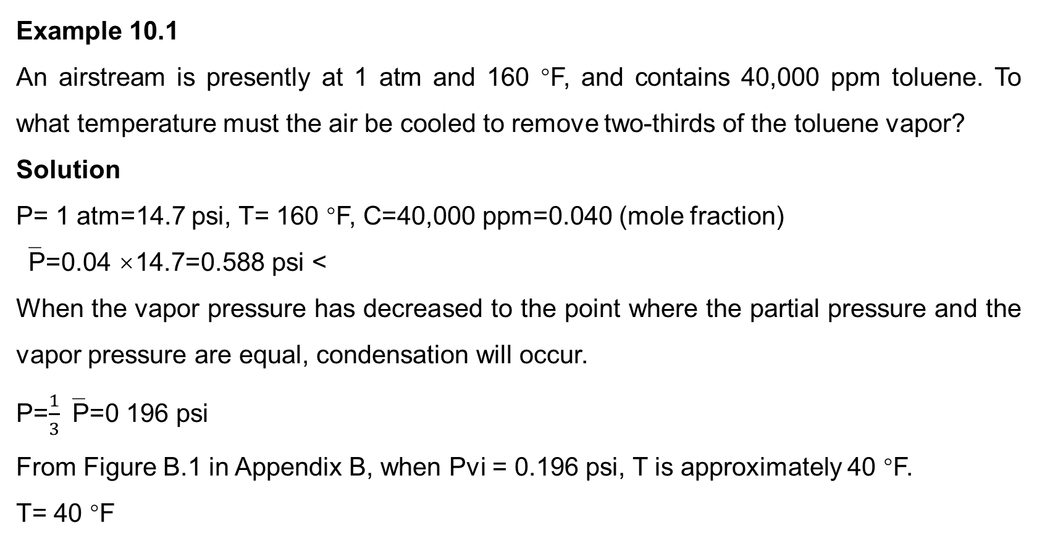
10.2 Vapor Pressure
Example 10.1
An airstream is presently at 1 atm and 160 °F, and contains 40,000 ppm toluene. To what temperature must the air be cooled to remove two-thirds of the toluene vapor?
Solution
P= 1 atm=14.7 psi, T= 160 °F, C=40,000 ppm=0.040 (mole fraction)
‾P=0.04 ×14.7=0.588 psi <
When the vapor pressure has decreased to the point where the partial pressure and the vapor pressure are equal, condensation will occur.
P=$\frac{1}{3}$‾P=0 196 psi
From Figure B.1 in Appendix B, when Pvi = 0.196 psi, T is approximately 40 °F.
T= 40 °F

Slide 13
10.1 Introduction 10.2 Vapor Pressure 10.3 Diffusivities 10.4 Gas-Liquid and Gas-Solid Equilibria 10.5 Chemical Reactions
CONTENTS

Slide 14
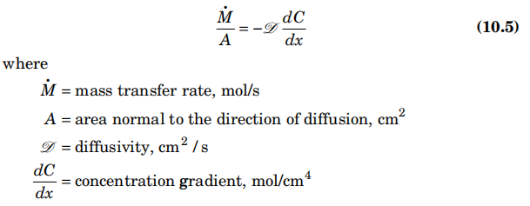
10.3 Diffusivities
The second law of thermodynamics explains that matter will diffuse spontaneously from a region of high concentration to one of low concentration. Fick’s first law can be taken as a definition of the diffusivity.
Diffusivity is the (proportionality) constant between the rate of flux of matter and the concentration gradient. Thus,
Since the concentration decreases in the direction of diffusion, a negative sign is necessary in Eq. (10.5).

Slide 15
10.1 Introduction 10.2 Vapor Pressure 10.3 Diffusivities 10.4 Gas-Liquid and Gas-Solid Equilibria 10.5 Chemical Reactions
CONTENTS

Slide 16
10.4 Gas-Liquid and Gas-Solid Equilibria
Solubility
In the absorption process, once a gas molecule has diffused through the stagnant gas film it must be absorbed into the liquid. Normally, we assume that at an interface (which has no depth), local equilibrium is established virtually instantaneously.
Once absorbed, the pollutant then diffuses through a stagnant liquid film into the bulk liquid.
However, even though the rate of absorption is very fast and thus not a limitation, the extent of absorption (the solubility) is crucial to the overall objective of mass transfer.

Slide 17
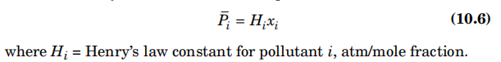
10.4 Gas-Liquid and Gas-Solid Equilibria
Henry’s law
For dilute solutions, the concentrations of the pollutant in the gas and the liquid are often linearly related. This relationship is known as Henry’s law, which can be expressed as
Appendix B presents some data on Henry’s law constants.
Note that (1) all Henry’s law constants have units, (2) Henry’s law constants vary with temperature, and (3) as xi increases, the relationship eventually becomes nonlinear; that is, at some value of xi, Eq. (10.6) is no longer valid.

Slide 18
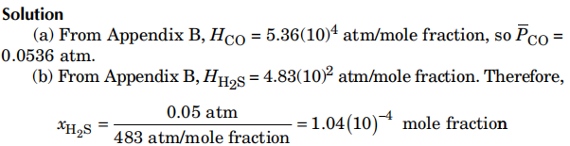
10.4 Gas-Liquid and Gas-Solid Equilibria
Example 10.2
Calculate the equilibrium partial pressure of CO in air that is in contact with water that is at 20 °C and has a 1.0(10)^{–6} mole fraction of CO.
(b) Calculate the mole fraction of H2S in water that is in contact with air that is at 20 °C and contains H2S with a partial pressure of 0.05 atm.

Slide 19
10.4 Gas-Liquid and Gas-Solid Equilibria
Adsorption
Adsorption is another type of equilibrium that is important in air pollution work. Adsorption involves a gas–solid equilibrium that is quite similar in principle to the solubility equilibrium exhibited by gas–liquid systems. However, the equilibrium relationships are rarely linear.
When air containing a pollutant vapor is contacted with certain solids and allowed sufficient time to equilibrate, some of the vapor molecules will have been attracted to and retained by the solid surface.
The amount adsorbed on the solid depends on the type of vapor, the partial pressure of the vapor, the type of solid, the amount of surface area available for adsorption, and the temperature.

Slide 20
10.4 Gas-Liquid and Gas-Solid Equilibria
Physisorption & Chemisorption
Physical adsorption is exothermic, giving up an amount of heat similar to the heat of condensation.
Chemisorption involves the breaking and re-forming of bonds, and is much more energetic than physical adsorption.
The state of matter of the vapor molecules on the surface can be somewhere between liquid and vapor, and there can be either several layers or a single layer of molecules on the surface.
Physical adsorption is reversible, and this characteristic is used as a means of separating VOCs from air.
The principle solid used in air pollution control is activated carbon.

Slide 21
10.1 Introduction 10.2 Vapor Pressure 10.3 Diffusivities 10.4 Gas-Liquid and Gas-Solid Equilibria 10.5 Chemical Reactions
CONTENTS

Slide 22
10.5 Chemical Reactions
After absorption or adsorption occurs, a chemical reaction often takes place to permanently change the pollutant to a less harmful form.
Two fundamental principles of chemical reactions—kinetics and thermodynamics.
Kinetics
For our purposes, the study of kinetics is the study of chemical reaction rates. A chemical reaction rate can be expressed as the rate of “disappearance” of reactants or the rate of “appearance” of products.

Slide 23
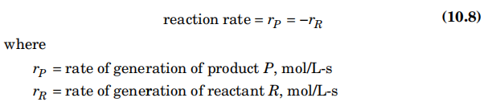
10.5 Chemical Reactions
Kinetics
We will use the symbol ri to indicate the appearance rate or generation rate of component i. Since products are generated and reactants are “used up,” ri is positive if i is a product and negative if I is a reactant. However, the rate of reaction is always positive. Thus,
Reaction rates have units of moles/(volume-time).

Slide 24
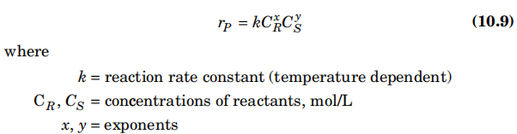
10.5 Chemical Reactions
Kinetics
The rate of reaction is proportional to the concentrations of the reactants (frequency of collisions) and to the temperature (energy of collisions). Consider the reaction
R + S → P + Q
The rate of reaction can be expressed as

Slide 25
10.5 Chemical Reactions
The reaction is said to be of order x in reactant R, of order y in reactant S, and of order (x + y) overall. Often (but not always), x and y are simple whole numbers that are related to the stoichiometry. However, x and y usually must be determined experimentally.
Reaction rate constant
Reaction rate constant (k) is a quantitative expression of chemical reaction rate ‌. Its physical significance is that the value is equivalent to the reaction rate when the substances participating in the reaction are at the unit concentration (1 mol·L⁻¹), so it is also called the specific rate of reaction. ‌

Slide 26
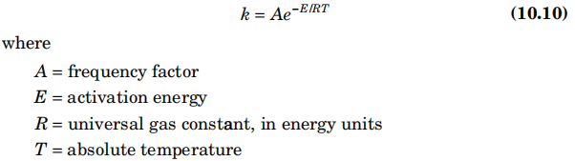
10.5 Chemical Reactions
Arrhenius equation
The rate constant k is usually represented by an Arrhenius equation such as
The units on k depend on the order of the reaction, but the units on E, R, and T must be consistent so that E/RT is dimensionless. For example, one consistent set of units is for E to be in cal/gmol, R to be in 1.987 cal/gmol-K, and T to be in K.

Slide 27
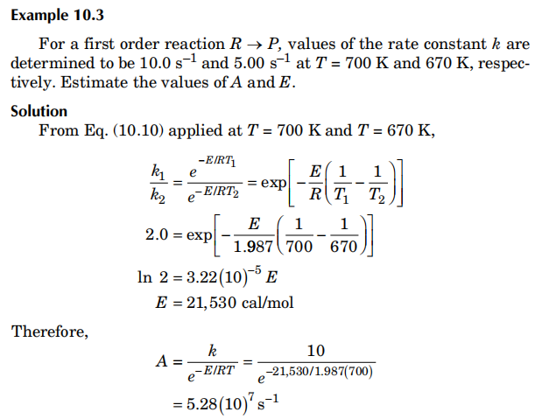
10.5 Chemical Reactions

Slide 28
10.5 Chemical Reactions
Thermodynamics
Many reactions are very energetic. Some reactions release large amounts of heat (exothermic), whereas others require considerable heat input (endothermic).
One obvious effect of such heat release or absorption is that it changes the temperature of the reacting mix and thus affects the reaction rates.
Another effect is that, for gases, a change in temperature affects the concentrations (in mol/L but not in mole fraction) and the volumetric flow rates.

Slide 29
10.5 Chemical Reactions
Generally, the equilibrium constants for exothermic reactions decrease with increasing temperature. On the other hand, kinetic constants always increase with temperature.
Therefore, it is possible for an optimum temperature to exist for the conversion of a given reactant to a given product. The optimum temperature will be high enough to allow the reactions to proceed rapidly, yet low enough to allow the equilibrium to achieve the desired degree of conversion.

